Slide 1
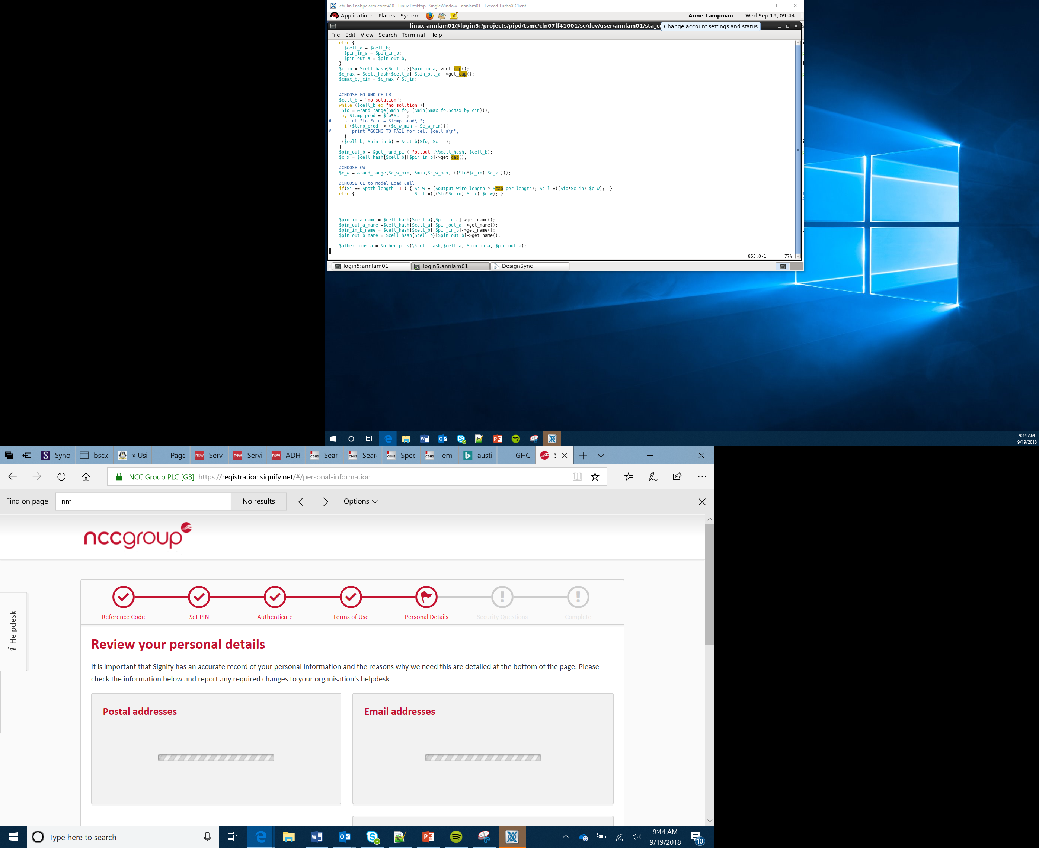
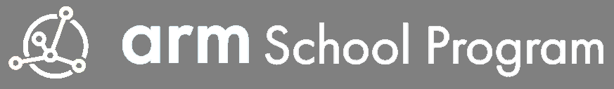
Smart Robotics Project
Electronics
Lesson 15

Slide 2
Objectives
Understand the function of basic electronic components
Use a micro:bit to control motors and servos
Use a micro:bit to control the output from a speaker

Slide 3
Electronics
There are many different types of electrical and electronic components, including resistors, capacitors and LEDs. Each of these has a specific use in a circuit.
We will need to use these components when designing our vehicle’s nervous system and how it will interact with the outside world (The Human Computer Interaction)
Resistors
Resistors restrict or limit the flow of current in a circuit this is measured in ohms.
There are three main types of resistor:
Fixed resistors – used to protect components and control time delays
Variable resistors – can be altered continually as they work, e.g. volume controls
Special resistors, such light-dependent resistors (LDRs) – change resistance as the light level changes or as temperature changes
Notes:
Discuss and show examples of common electronic components – explain the basic uses
This is also a good opportunity to re-utilise LEDS and Neopixel and refer to these as electronic components

Slide 4
Electronics
Capacitors
A capacitor is a component that stores an electrical charge. The larger its capacitance the larger the charge it can store. This is measured in Farads
Capacitors are used to smooth alternating current into steady direct current and can filter our fluctuations in signals
LEDs (Light Emitting Diodes)
A light emitting diode (LED) is a kind of diode that glows when electricity passes through it
They can be made in a range of colours and, as we have already seen, some LEDs can be programmed to change colour
LEDs have two pins a longer pin called the Anode (+) and a shorter pin called the Cathode (-)
Notes:
Discus and show examples of common electronic components – explain the basic uses
This is also a good opportunity to re-utilise LEDS and Neopixel and refer to these as electronic components

Slide 5
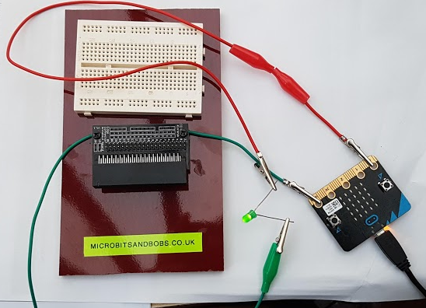
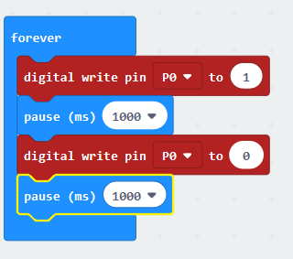
Experiment
Connect your micro:bit either with a connector breakout board or directly using crocodile clips to an LED
In the example below we are connecting the ground pin to the LEDs cathode (shorter pin) and Pin 0 to the anode (longer pin)
By sending a signal to the pin we can turn the LED on or OFF
Notes:
Demonstrate and let student experiment. Get them to look at how they could control more than one LED.

Slide 6
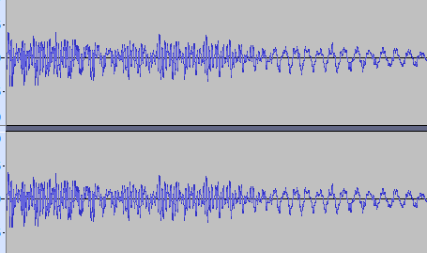
Sensors
Sensors enable us to detect environmental factors using our computer (micro:bit)
Sensors can be Analogue or Digital
Analogue signals vary continually in frequency (how close together) and amplitude (how high) the wave is
Digital signals consist of just two states, on (1) and off(0) with no values in between
Example of someone speaking, recorded using an analogue microphone
Look at your micro:bit and Bit:Bot we have the following sensors available to use:
Light, line, temperature, ultrasonic, acceleration, magnetic field
Which of these sensors is likely to give us a digital and which will give an analogue reading?
Notes:
Discuss analogue and digital data again from sensors, use software like Audacity to record your voice from a microphone and show the sound wave. The picture in the lesson is an example of this.
Review the sensors we’ve used and ask Learners to think about which are analogue and which are digital

Slide 7
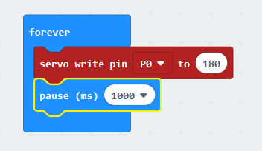
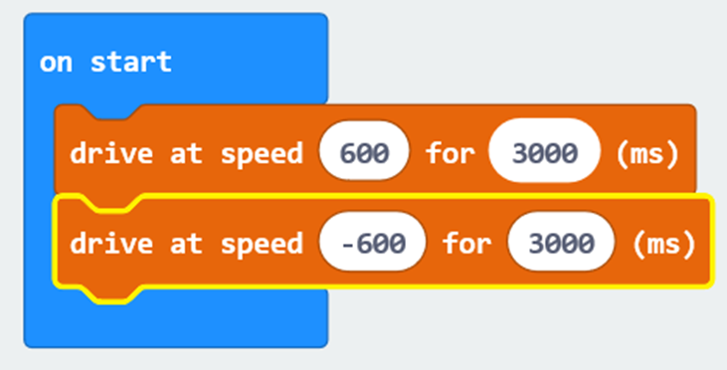
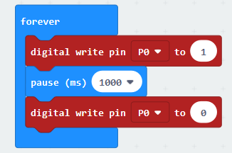
Motors and Servos
Motors
An electric motor can be attached to rotate or spin a device, this could be attached to a wheel to give us motion or to a pully and cable.
Servo
A servo is used to give measured rotation usually across 180 degree.
This could be attached to say the jaws of a digger or the flaps of an aeroplane to give a controlled amount of movement
Servos can be controlled directly via the micro:bit’s Servo block
Motors can be controlled directly by sending a 1 or 0 to the correct pin
Motors on the Bit:Bot can also be controlled more precisely with Drive block
Notes:
Learners will be aware of motors already but explain what a servo does. If you have access to one demonstrate its use using the code above.
Discuss uses for servos eg flaps on an aeroplane. Some Learners might be aware of this use through model aircraft.

Slide 8
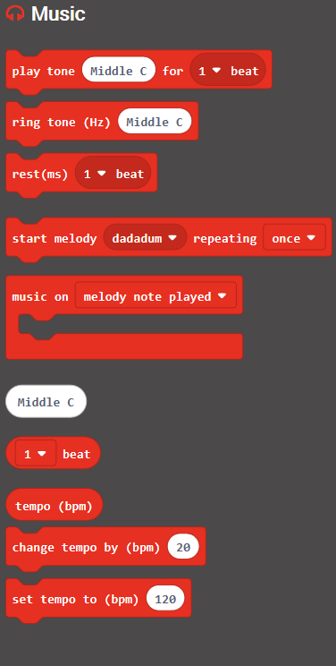
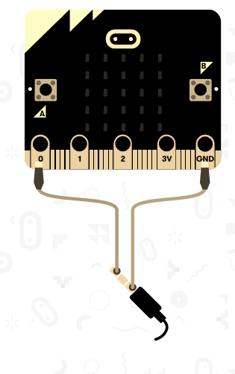
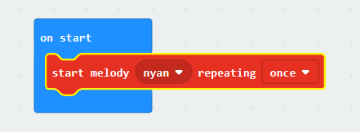
Speaker/Buzzers
Speakers and Buzzers
These are output devices we can connect to our controller (micro:bit) to enable audio output. This might be in the form of simple beeps but can be much more tuneful!
Connect a set of headphones or speakers as shown
Flash a micro:bit with the sample program below
Use the block in the music section to create your own tune
Notes:
Demonstrate how you can connect the micro:bit to a set of headphones using crocodile clips and play music
Explain that the built in audio device for the micro:bit enables Learners to alter the notes and pitch of sound being played
Give the Learners an opportunity to experiment

Slide 9
Success Criteria
Understand the function of basic electronic components
Use a micro:bit to control motors and servos
Use a micro:bit to control the output from a speaker
Notes:
Support Learners with the lesson activity
Encourage good programming constructs of sequence, selection and iteration

